Slide 1
FIN
IT Applications
Issues/Concerns/Priorities
Toshiba Information Equipment Phials.,Inc.
2019.04.11
Scope of Disclosure | TIP-ISD-IS3
Head of Information Owner Section | ISD

Slide 2
OUTLINE
01
Issues
02
-
03
-
04
-
05
-

Slide 3
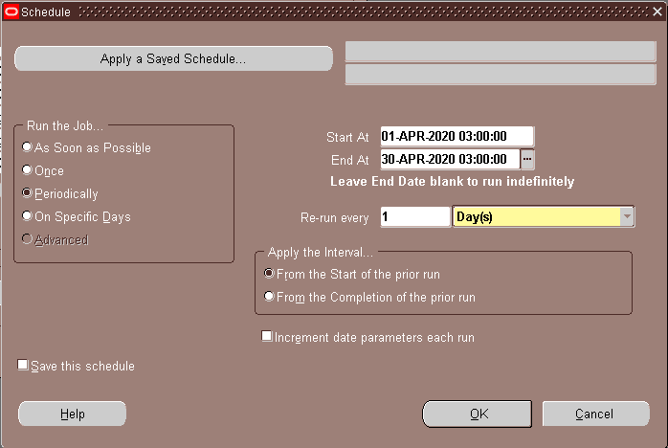
[ISSUE] Increased Pending Transactions in GL Receiving Transactions to GAIA
BACKGROUND: Incorrect set up for Auto Process GL Receiving Transactions program for 2019 Fiscal Year. Execution date schedule was set to year 2020 which was supposedly for April 2019 execution.
EFFECT: Pending receiving transactions increased to 29,702 records from April 1 –10, 2019.

Slide 4
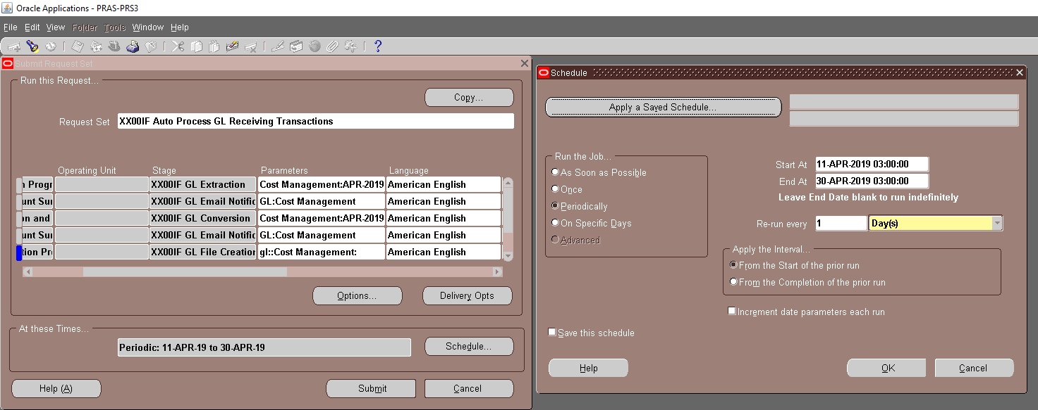
[ISSUE] Increased Pending Transactions in GL Receiving Transactions to GAIA
IMMEDIATE ACTION: Changed execution schedule starting April 11, 2019 up to April 30, 2019.
STATUS: Auto Process GL Receiving Transactions program started execution on April 11, 2019
NEXT ACTION:
Business Side: ???
System Side: 1. ) Program Tuning of GL Data Conversion and Error Check Program

